Slide 1
IMSE 991 Multiple Criteria Decision Making
Lecture 7
TOPSIS and SAW

Slide 2
TOPSIS and SAW
Simple Additive Weights
Weighted Product
Technique for Order Preference for Similarity to Ideal Solution (TOPSIS)
TOPSIS Sensitivity Analysis
Use of MADM in Patentable Processes

Slide 3
TOPSIS and SAW
Useful methods in that they are easy to use and easy to understand
Relatively well know
Very well accepted by the “lay” person making decisions

Slide 4
Simple Additive Weighting Method
The simple additive weighting method (SAW) is probably the best-known and widely used method of multiple attribute decision making.
The decision maker assigns importance weights to each attribute, which become the coefficients of the variables.
These weighted coefficients need to be normalized.
To reflect the decision maker’s marginal worth assessments within attributes, the decision maker also makes a numerical scaling of intra-attribute values.

Slide 5
Simple Additive Weighting Method
The decision maker can then obtain a total score for each alternative simply by
Multiplying the scale rating for each attribute value by the importance weight assigned to the attribute
Summing these products over all attributes.
After the total scores are computed for each alternative, the alternative with the highest score (the highest weighted average) is the one prescribed to the decision maker.

Slide 6
SAW Precautions
Important precaution when developing decision models.
Scaling: Scaling of criteria value can greatly influence the impact of single criteria and thus the ranking. To avoid this problem, all values within a criterion are normalized.
Independence: Care should be taken so that all the criteria are independent, thus avoiding overweighing the effects of a single criterion.

Slide 7
SAW
Simple Additive Weighting – Weighted Average – Weighted Sum A global (total) score in the SAW is obtained by adding contributions from each attribute.
A common numerical scaling system such as normalization (instead of single dimensional value functions) is required to permit addition among attribute values.
Value (global score) of an alternative can be expressed as:
V(a_{i}) = V_{i} =

Slide 8
SAW Example I
Raw Data
 | Minimize | Maximize | Maximize | Maximize
 | Price | Comfort | Performance | Design
a1 | 300 | 3 | 3 | 3
a2 | 250 | 3 | 2 | 3
a3 | 250 | 2 | 3 | 3
a4 | 200 | 2 | 3 | 2
a5 | 200 | 2 | 2 | 3
a6 | 200 | 1 | 3 | 3
a7 | 100 | 1 | 2 | 2

Slide 9
SAW Example I
Find Best Score Based on Minimizing or Maximizing
 | Minimize | Maximize | Maximize | Maximize
 | Price | Comfort | Performance | Design
a1 | 300 | 3 | 3 | 3
a2 | 250 | 3 | 2 | 3
a3 | 250 | 2 | 3 | 3
a4 | 200 | 2 | 3 | 2
a5 | 200 | 2 | 2 | 3
a6 | 200 | 1 | 3 | 3
a7 | 100 | 1 | 2 | 2
Best Score | 100 | 3 | 3 | 3

Slide 10
SAW Example I
Normalize the Decision Matrix
Minimized Attribute = min(x_{ij})/x_{ij}
Maximized Attribute = x_{ij}/max(x_{ij})
 | Price | Comfort | Perf. | Design
a1 | 0.333 | 1.000 | 1.000 | 1.000
a2 | 0.400 | 1.000 | 0.667 | 1.000
a3 | 0.400 | 0.667 | 1.000 | 1.000
a4 | 0.500 | 0.667 | 1.000 | 0.667
a5 | 0.500 | 0.667 | 0.667 | 1.000
a6 | 0.500 | 0.333 | 1.000 | 1.000
a7 | 1.000 | 0.333 | 0.667 | 0.667

Slide 11
SAW Example I
Weight the Attributes
 | Normalized Weights
 | 0.333 | 0.267 | 0.200 | 0.200
 | Price | Comfort | Perf. | Design
a1 | 0.333 | 1.000 | 1.000 | 1.000
a2 | 0.400 | 1.000 | 0.667 | 1.000
a3 | 0.400 | 0.667 | 1.000 | 1.000
a4 | 0.500 | 0.667 | 1.000 | 0.667
a5 | 0.500 | 0.667 | 0.667 | 1.000
a6 | 0.500 | 0.333 | 1.000 | 1.000
a7 | 1.000 | 0.333 | 0.667 | 0.667

Slide 12
SAW Example I
Normalized Decision Matrix and Global Scores
Multiply the normalized weights by the normalized attribute values for each alternative and sum
 | Normalized Weights
 | 0.333 | 0.267 | 0.200 | 0.200
 | Price | Comfort | Perf. | Design | Score
a1 | 0.333 | 1.000 | 1.000 | 1.000 | 0.778
a2 | 0.400 | 1.000 | 0.667 | 1.000 | 0.733
a3 | 0.400 | 0.667 | 1.000 | 1.000 | 0.711
a4 | 0.500 | 0.667 | 1.000 | 0.667 | 0.678
a5 | 0.500 | 0.667 | 0.667 | 1.000 | 0.678
a6 | 0.500 | 0.333 | 1.000 | 1.000 | 0.656
a7 | 1.000 | 0.333 | 0.667 | 0.667 | 0.689

Slide 13
SAW Example II
Each alternative is evaluated against each of the five attributes or criteria.
When all attribute values have the same scaling, it is not necessary to normalize the scale
You must reflect “bigger is better” or “smaller is better” in the scaling
Two of the criteria, however, have different scaling than the remaining inputs where the scale is from 1 (low) to 5 (high) in the evaluation.
Cost and economic benefit criteria use different scales which are converted to equitable scaling

Slide 14
SAW Example II
Different criteria weights can result in different rankings.
The weights are multiplied by the decision criteria values for each of the attributes for an alternative and are summed to represent a score for the alternative.

Slide 15
SAW Example II
 |  | Importance Weight
 |  | 10% | 25% | 20% | 15% | 30%
Alternatives | Development Cost | Development Cost | Inventory Investment | System Interface (Scale - 1 (low) to 5 (high)) | Transportation Cost | Economic Benefit | Score
 |  | (See Scale) | (Scale - 1 (low) to 5 (high)) |  | (Scale - 1 (low) to 5 (high)) | (See Scale)
System Enhancements | $8,000,000 | 1 | 3 | 5 | 3 | 4 | 3.5
Acquisition Improvements | $1,500,000 | 3 | 3 | 3 | 2 | 2 | 2.55
Transportation Optimization | $2,000,000 | 3 | 2 | 1 | 5 | 4 | 2.95
Repair Cost Reduction | $8,000,000 | 5 | 2 | 1 | 2 | 3 | 2.4
Economic Benefit Scale
1- very low <$500K
2 - low >=$500K to <$1M
3 - medium >=$1M to <$2.5M
4 - high>= $2.5M to <$5M
5- very high >=$5M
Development Cost Scale
5 - very low <$500K
4 - low >=$500K to <$1M
3 - medium >=$1M to <$2.5M
2 - high>= $2.5M to <$5M
1 - very high >=$5M
Both 1 – 5 Scales

Slide 16
SAW Example II
In this case, the alternative, “System Enhancements” will provide the greatest value to the company
The evaluation of the alternative
The importance weighting of the decision criteria.

Slide 17
TOPSIS Method
TOPSIS stands for the Technique of Order Preference by Similarity to Ideal Solution
The TOPSIS method is very versatile
It allows for both qualitative and quantitative data in its original form for the decision process

Slide 18
TOPSIS Method
Attributes are identified as either cost or benefit attributes associated with the criteria data
Additionally, the attributes or decision criteria are weighted to reflect the importance assigned by the decision maker

Slide 19
TOPSIS Method
In this method two alternatives are developed
Ideal alternative: the one which has the best level for all attributes considered.
Negative ideal alternative: the one which has the worst attribute values.
TOPSIS selects the alternative that is the closest to the ideal solution and farthest from negative ideal alternative.

Slide 20
TOPSIS Method
TOPSIS assumes that we have m alternatives (options) and n attributes/criteria and we have the score of each option with respect to each criterion.
Let x_{ij} score of option i with respect to criterion j
We have a matrix X = (x_{ij}) mxn matrix.
Let J be the set of benefit attributes or criteria (bigger is better)
Let J' be the set of negative attributes or criteria (less is better)

Slide 21
TOPSIS Method
Steps in the process
Calculate the normalized ratings
Calculate the weighted normalized ratings
Identify the positive-ideal and negative-ideal solutions
Calculate separation measures
Calculate similarities to the positive-ideal and negative-ideal solutions
Rank preference order

Slide 22
TOPSIS Method
Step 1: Construct normalized decision matrix.
This step transforms various attribute dimensions into non-dimensional attributes, which allows comparisons across criteria.
Normalize scores or data as follows:
r_{ij} = x_{ij}/ (Σx²_{ij}) for i = 1, …, m; j = 1, …, n
^{i}

Slide 23
TOPSIS Method
Step 2: Construct the weighted normalized decision matrix.
Assume we have a set of weights for each criteria w_{j} for j = 1,…n.
Multiply each column of the normalized decision matrix by its associated weight.
An element of the new matrix is:
v_{ij} = w_{j} r_{ij}

Slide 24
TOPSIS Method
Step 3: Determine the ideal and negative ideal solutions.
Ideal solution.
A* = { v₁* , …, v_{n}*}, where
v_{j}* ={ max (v_{ij}) if j ∈ J ; min (v_{ij}) if j ∈ J' }
i i
Negative ideal solution.
A' = { v₁' , …, v_{n}' }, where
v' = { min (v_{ij}) if j ∈ J ; max (v_{ij}) if j ∈ J' }
^{i} ^{i}

Slide 25
TOPSIS Method
Step 4: Calculate the separation measures for each alternative.
The separation from the ideal alternative is:
S_{i} * = [ Σ (v_{j}*– v_{ij})² ] ^{½} i = 1, …, m
^{j}
Similarly, the separation from the negative ideal alternative is:
S'_{i} = [ Σ (v_{j}' – v_{ij})² ] ^{½} i = 1, …, m
^{j}

Slide 26
TOPSIS Method
Step 5: Calculate the relative closeness to the ideal solution C_{i}*
C_{i}* = S'_{i} / (S_{i}* +S'_{i} ) , 0 < C_{i}* < 1
Step 6: Rank Order the Alternatives.
Select the option with C_{i}* closest to 1.

Slide 27
TOPSIS Method
Example – Automobile Selection
Input Weights | 10 | 40 | 30 | 20
Attribute Weights | 10% | 40% | 30% | 20%
 | BENEFIT | BENEFIT | BENEFIT | COST
Altermantives | Style | Reliability | Fuel Economy | Cost
Civic | 7 | 9 | 35 | 26000
Saturn | 8 | 7 | 28 | 30000
Ford | 9 | 6 | 25 | 22000
Mazda | 6 | 6 | 35 | 24000

Slide 28
TOPSIS Method
m = 4 alternatives (car models)
n = 4 attributes/criteria
x_{ij} = score of option i with respect to criterion j
X = {x_{ij}} 4×4 score matrix.
J = set of benefit attributes: style, reliability, fuel economy (bigger is better)
J' = set of negative attributes: cost (less is better)

Slide 29
TOPSIS Method
Step 1:
calculate (Σx²_{ij} )^{1/2} for each column
divide each column by (Σx²_{ij} )^{1/2} to get r_{ij}
Attribute Name | Style | Reliability | Fuel Economy | Cost
Attribute Weights | 10% | 40% | 30% | 20%
 | BENEFIT | BENEFIT | BENEFIT | COST
Civic | 0.0462 | 0.2533 | 0.1690 | 0.1013
Saturn | 0.0528 | 0.1970 | 0.1352 | 0.1169
Ford | 0.0593 | 0.1689 | 0.1207 | 0.0857
Mazda | 0.0396 | 0.1689 | 0.1690 | 0.0935

Slide 30
TOPSIS Method
Step 2:
multiply each column by w_{j} to get v_{ij}.
determine ideal solution A*.
find negative ideal solution A'.
 | Style | Reliability | Fuel Economy | Cost
PIS | 0.0593 | 0.2533 | 0.1690 | 0.0857
NIS | 0.0396 | 0.1689 | 0.1207 | 0.1169

Slide 31
TOPSIS Method
Step 4:
find separation from ideal solution A*
S_{i}* = [ Σ (v_{j}*– v_{ij})² ] ^{½} for each row j
find separation from negative ideal solution A'
S_{i}' = [ Σ (v_{j}'– v_{ij})² ] ^{½} for each row j
Attribute Name | Style | Reliability | Fuel Economy | Cost
Attribute Weights | 10% | 40% | 30% | 20%
 | BENEFIT | BENEFIT | BENEFIT | COST | S* | S⁻
Civic | 0.0462 | 0.2533 | 0.1690 | 0.1013 | 0.0204 | 0.0987
Saturn | 0.0528 | 0.1970 | 0.1352 | 0.1169 | 0.0730 | 0.0343
Ford | 0.0593 | 0.1689 | 0.1207 | 0.0857 | 0.0973 | 0.0369
Mazda | 0.0396 | 0.1689 | 0.1690 | 0.0935 | 0.0871 | 0.0537

Slide 32
TOPSIS Method
Step 5:
Calculate the relative closeness to the ideal solution C_{i}* = S'_{i} / (S_{i}* +S'_{i} )
Attribute Name | Style | Reliability | Fuel Economy | Cost
Attribute Weights | 10% | 40% | 30% | 20%
 | BENEFIT | BENEFIT | BENEFIT | COST | S* | S⁻ | Relative Score C*
Civic | 0.0462 | 0.2533 | 0.1690 | 0.1013 | 0.0204 | 0.0987 | 0.8287
Saturn | 0.0528 | 0.1970 | 0.1352 | 0.1169 | 0.0730 | 0.0343 | 0.3197
Ford | 0.0593 | 0.1689 | 0.1207 | 0.0857 | 0.0973 | 0.0369 | 0.2751
Mazda | 0.0396 | 0.1689 | 0.1690 | 0.0935 | 0.0871 | 0.0537 | 0.3813

Slide 33
TOPSIS Method
Step 6:
Rank Order the Alternatives
Auto | Relative Score | Rank
Civic | 0.8287 | 1
Mazda | 0.3813 | 2
Saturn | 0.3197 | 3
Ford | 0.2751 | 4

Slide 34
TOPSIS Example II
Product Selection Example
 | BENEFIT | COST | BENEFIT | BENEFIT | BENEFIT | COST
Products | Strategic Alignment (1-Low to 5-high) | Competitive Barriers (1-Low to 5-high) | Market Growth Potential | Probability of Technical Success | After Tax Margin/ROI | Initial Investment (millions)
Product A | 3 | 1 | 1% | 71% | 21% | $ 11.4
Product B | 5 | 3 | 2% | 64% | 11% | $ 14.0
Product C | 4 | 2 | 5% | 95% | 25% | $ 20.0
Product D | 5 | 4 | 3% | 94% | 18% | $ 12.6
Product E | 3 | 3 | 2% | 85% | 8% | $ 15.1
Product F | 3 | 2 | 3% | 71% | 26% | $ 12.5
Product G | 4 | 3 | 4% | 85% | 6% | $ 14.0
Product H | 2 | 2 | 3% | 68% | 30% | $ 18.5
Product I | 3 | 3 | 3% | 82% | 2% | $ 9.2
Product J | 2 | 4 | 8% | 81% | 32% | $ 16.4

Slide 35
TOPSIS Example II
PIS and NIS for Example
 | Strategic Alignment (1-Low to 5-high) | Competitive Barriers (1-Low to 5-high) | Market Growth Potential | Probability of Technical Success | After Tax Margin/ROI | Initial Investment (millions)
PIS | 5 | 1 | 8% | 95% | 32% | $ 9.2
NIS | 2 | 4 | 1% | 64% | 2% | $ 20.0

Slide 36
TOPSIS Example II
Weighted Normalized Matrix
Attribute Name | Strategic Alignment (1-Low to 5-high) | Competitive Barriers (1-Low to 5-high) | Market Growth Potential | Probability of Technical Success | After Tax Margin/ROI | Initial Investment (millions)
Attribute Weights | 20% | 10% | 15% | 15% | 30% | 10%
 | BENEFIT | COST | BENEFIT | BENEFIT | BENEFIT | COST
Product A | 0.0535 | 0.0111 | 0.0122 | 0.0420 | 0.0970 | 0.0245
Product B | 0.0891 | 0.0333 | 0.0243 | 0.0378 | 0.0508 | 0.0301
Product C | 0.0713 | 0.0222 | 0.0608 | 0.0562 | 0.1155 | 0.0430
Product D | 0.0891 | 0.0444 | 0.0365 | 0.0556 | 0.0832 | 0.0271
Product E | 0.0535 | 0.0333 | 0.0243 | 0.0502 | 0.0370 | 0.0325
Product F | 0.0535 | 0.0222 | 0.0365 | 0.0420 | 0.1201 | 0.0269
Product G | 0.0713 | 0.0333 | 0.0486 | 0.0502 | 0.0277 | 0.0301
Product H | 0.0356 | 0.0222 | 0.0365 | 0.0402 | 0.1386 | 0.0398
Product I | 0.0535 | 0.0333 | 0.0365 | 0.0485 | 0.0092 | 0.0198
Product J | 0.0356 | 0.0444 | 0.0990 | 0.0479 | 0.1479 | 0.0353

Slide 37
TOPSIS Example II
PIS and NIS for Example – From Weighted/Normalized Matrix
 | Strategic Alignment (1-Low to 5-high) | Competitive Barriers (1-Low to 5-high) | Market Growth Potential | Probability of Technical Success | After Tax Margin/ROI | Initial Investment (millions)
PIS | 0.0891 | 0.0111 | 0.0990 | 0.0562 | 0.1479 | 0.0198
NIS | 0.0356 | 0.0444 | 0.0122 | 0.0378 | 0.0092 | 0.0430

Slide 38
TOPSIS Example II
Separation Measures
 | S* | S⁻
Product A | 0.1078 | 0.0974
Product B | 0.1262 | 0.0709
Product C | 0.0590 | 0.1255
Product D | 0.0962 | 0.0974
Product E | 0.1408 | 0.0403
Product F | 0.0795 | 0.1182
Product G | 0.1339 | 0.0582
Product H | 0.0873 | 0.1336
Product I | 0.1579 | 0.0410
Product J | 0.0654 | 0.1641

Slide 39
TOPSIS Example II
Relative Score
 | S* | S⁻ | Relative Score C*
Product A | 0.1078 | 0.0974 | 0.4749
Product B | 0.1262 | 0.0709 | 0.3597
Product C | 0.0590 | 0.1255 | 0.6802
Product D | 0.0962 | 0.0974 | 0.5030
Product E | 0.1408 | 0.0403 | 0.2224
Product F | 0.0795 | 0.1182 | 0.5980
Product G | 0.1339 | 0.0582 | 0.3030
Product H | 0.0873 | 0.1336 | 0.6047
Product I | 0.1579 | 0.0410 | 0.2063
Product J | 0.0654 | 0.1641 | 0.7150

Slide 40
TOPSIS Example II
Rank Order of Products
Product | Relative Score | Rank
Product J | 0.7150 | 1
Product C | 0.6802 | 2
Product H | 0.6047 | 3
Product F | 0.5980 | 4
Product D | 0.5030 | 5
Product A | 0.4749 | 6
Product B | 0.3597 | 7
Product G | 0.3030 | 8
Product E | 0.2224 | 9
Product I | 0.2063 | 10

Slide 41
TOPSIS Example II
Product J has
Higher score for strategic alignment (4)
Lower competitive barriers (2)
Highest market growth potential (8 percent)
High probability of technical success (81 percent)
Highest after-tax margin/ROI (32 percent)
But….it does have a higher initial investment ($16.4 million).

Slide 42
TOPSIS Example II
The importance weights are drivers in the calculation of the preference score and rank, as well.
This approach has been used in budget allocation consulting projects to select projects to fund based on the overall budget for the organization.
Using TOPSIS as a backbone for prioritizing projects and allocating resources to projects based on the available resources provides a logical, structured approach to resource allocation.

Slide 43
TOPSIS Sensitivity Analysis
Sensitivity Analysis
Sensitivity analysis is an important aspect of using structured methods in the decision-making process.
The initial solution is starting point in decision making.
The weights drive the product ranking and should not be overlooked.

Slide 44
TOPSIS Sensitivity Analysis
Sensitivity Analysis
Group decision-making techniques can be used to ensure that the weights are representative of the organization.
Testing the different rank order of products with different attribute weights can be done as part of sensitivity analysis with the solution.

Slide 45
TOPSIS Sensitivity Analysis
Sensitivity Analysis
Testing the modification of the individual attributes can provide decision makers with insight into how sensitive various values are to the resulting rank order.

Slide 46
TOPSIS Sensitivity Analysis
Sensitivity Analysis
Following are some potential types of sensitivity analysis that can be done
Test different weighting scenarios
Determine the difference that would be required in individual attribute values to move an alternative up in weight
Simulate different attribute value inputs into the decision model based on knowledge of the environment
And others…..

Slide 47
TOPSIS Sensitivity Analysis
Car Example Sensitivity Analysis
Attribute Value
Decision Matrix
Input Weights | 10 | 40 | 30 | 20
Attribute Weights | 10% | 40% | 30% | 20%
 | BENEFIT | BENEFIT | BENEFIT | COST
Alternatives | Style | Reliability | Fuel Economy | Cost
Civic | 7 | 7 | 30 | 26000
Saturn | 8 | 7 | 28 | 30000
Ford | 9 | 6 | 25 | 22000
Mazda | 6 | 6 | 35 | 24000
PIS | 9 | 7 | 35 | 22000
NIS | 6 | 6 | 25 | 30000
Computations
Attribute Name | Style | Reliability | Fuel Economy | Cost
Attribute Weights | 10% | 40% | 30% | 20%
 | BENEFIT | BENEFIT | BENEFIT | COST | S* | S⁻ | Relative Score C* | Rank
Civic | 0.0462 | 0.2148 | 0.1514 | 0.1013 | 0.0325 | 0.0432 | 0.5709 | 2
Saturn | 0.0528 | 0.2148 | 0.1413 | 0.1169 | 0.0476 | 0.0367 | 0.4353 | 3
Ford | 0.0593 | 0.1841 | 0.1262 | 0.0857 | 0.0591 | 0.0369 | 0.3846 | 4
Mazda | 0.0396 | 0.1841 | 0.1766 | 0.0935 | 0.0373 | 0.0556 | 0.5984 | 1
PIS | 0.0593 | 0.2148 | 0.1766 | 0.0857
NIS | 0.0396 | 0.1841 | 0.1262 | 0.1169
Original Ranking

Slide 48
TOPSIS Sensitivity Analysis
Car Example Sensitivity Analysis
Preference Weighting
Decision Matrix
Input Weights | 50 | 10 | 20 | 20
Attribute Weights | 50% | 10% | 20% | 20%
 | BENEFIT | BENEFIT | BENEFIT | COST
Alternatives | Style | Reliability | Fuel Economy | Cost
Civic | 7 | 9 | 35 | 26000
Saturn | 8 | 7 | 28 | 30000
Ford | 9 | 6 | 25 | 22000
Mazda | 6 | 6 | 35 | 24000
PIS | 9 | 9 | 35 | 22000
NIS | 6 | 6 | 25 | 30000
Computations
Attribute Name | Style | Reliability | Fuel Economy | Cost
Attribute Weights | 50% | 10% | 20% | 20%
 | BENEFIT | BENEFIT | BENEFIT | COST | S* | S⁻ | Relative Score C* | Rank
Civic | 0.2308 | 0.0633 | 0.1127 | 0.1013 | 0.0678 | 0.0530 | 0.4390 | 3
Saturn | 0.2638 | 0.0493 | 0.0901 | 0.1169 | 0.0526 | 0.0670 | 0.5604 | 2
Ford | 0.2967 | 0.0422 | 0.0805 | 0.0857 | 0.0385 | 0.1037 | 0.7293 | 1
Mazda | 0.1978 | 0.0422 | 0.1127 | 0.0935 | 0.1014 | 0.0398 | 0.2817 | 4
PIS | 0.2967 | 0.0633 | 0.1127 | 0.0857
NIS | 0.1978 | 0.0422 | 0.0805 | 0.1169
Original Ranking

Slide 49
Model and MADM Based Patentable Processes

Slide 50
Model and MADM Based Patentable Processes
What is Intellectual Property
What is a patent, and what is patentable?
Why are Industrial Engineering, Operations Research and Engineering Management Disciplines Poised to Patent?
Examples of Patentable Decision Models and Business Process Improvements

Slide 51
What is Intellectual Property?
Intellectual Property - ideas of the human mind
Protecting property rights of owner
Copyrights – Protects copying of specific expressions
Writings, presentations, software
Trademarks - Identifies source of goods or services
Logos, brands, slogans
Trade Secrets, Know How - Confidential information
Source code, processes, formulas, strategic information
Patents – Exclusive rights (typically 20 years)
Functional structures & processes
Non-protect-able property rights = in the public domain that can be used by anyone

Slide 52
Patent Goals
Increase Value of Technology and Obtain Competitive Advantage
Defensive (against third party claims)
Offensive
Supplier negotiations
Tax benefits

Slide 53
What is Patentable
The legal requirements for patentability under the patent statutes is NEW and NON-OBVIOUS
Most patent applications are based on modifications to existing products and/or processes
New – no one else doing it the same way
Non-obvious – not a minor or insignificant change
Types of patents: Utility patents (products and processes) Design patents (ornamental features)
Patentability is based on the “delta” - the difference between what is publicly known and what is new
An idea is not patentable if disclosed in the prior art or if obvious to one skilled in the art.
A patent must be filed within one year of public disclosure or “on sale”

Slide 54
Information on an Issued Patent
Cover sheet information - Inventor, assignee, prior art, filing date
Abstract and Drawings
Background of the invention - Problem you are solving and overview of the known technology
Detail description of the invention - Enablement for one skilled in the art
Claims (numbered paragraphs at the end) - Legal infringement scope defined by claims
Patent review is different for Infringement vs. Patentability
Infringement based on the claims
Patentability involves total patent

Slide 55
Why are We Poised to Patent
Industrial Engineering, Operations Research and Engineering Management Disciplines have a unique tools set that is used to improve the system of operation.
We provide systems, structure, decision models and business processes that can be both incremental or radical improvements.
Companies look to protect those ideas, processes, systems and models that have provided a competitive edge.
Those within these disciplines have the opportunity to patent new operational approaches.

Slide 56
Examples of Patentable Decision Models
Process for Predicting New Product Development Cycle Time
Statistical Analysis Capturing Operating Environment (Multiple Models)
Variable Selection
Model Update Procedures based on Fuzzy Logic
Enhancements to Project Predictor
Inclusion of Point-in-Time Data
Variable Addition for Analysis Cycle Time and Testing
Flexible Project Governance Model
Method to Govern Projects Based on Project Performance
Incorporate Project Management Measures – Earned Value
New Decision Making Methodology

Slide 57
Examples of Patentable Decision Models
Planning Team Indicator
Sparse Data Predictor Determining Need for Multiple Projects
Customer Service Complexity Model
Variable Selection
Learning Curve Methodology
Threshold Analysis based on Operational Performance

Slide 58
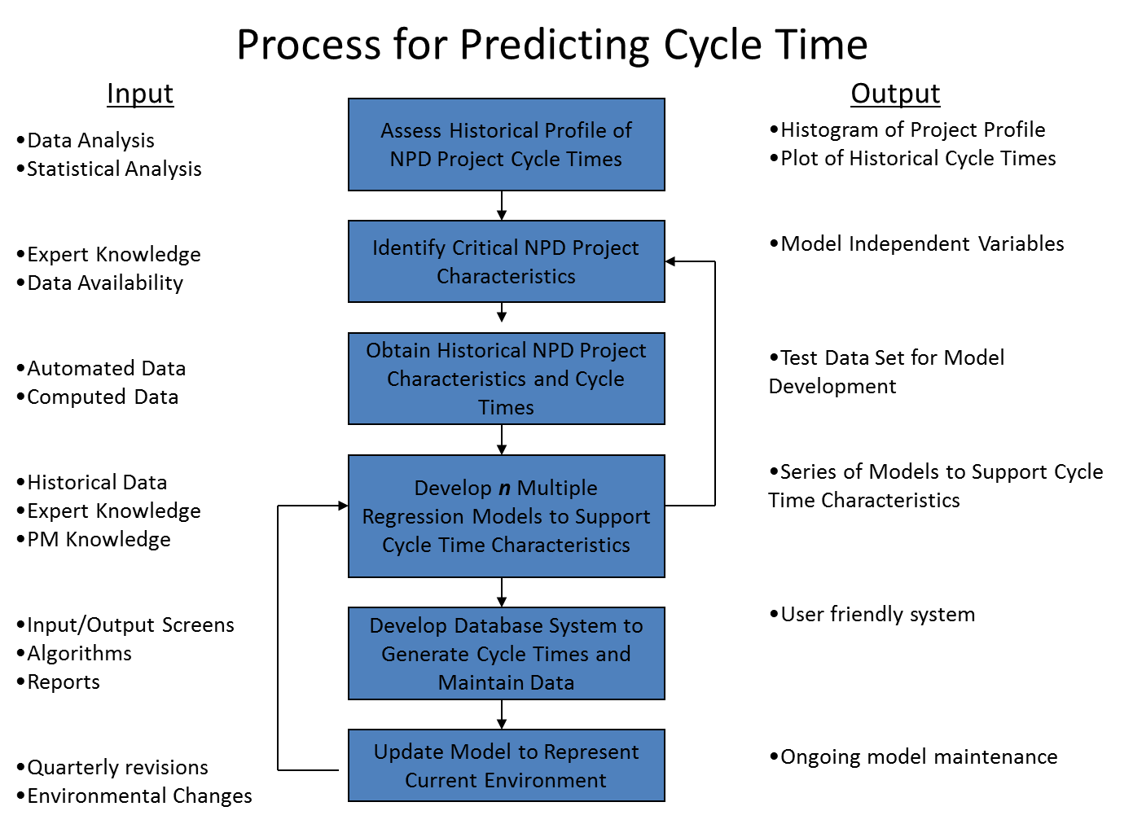

Slide 59
Cycle Time Model Results
Predictions Generated by the Model
Total Project Cost >$1,500,000
Predicted Cycle Time
Total Project Cost <=$1,500,000
Projects Sorted by Predicted Cycle Time
Two separate regression equations were used to predict cycle times.

Slide 60
Cycle Time Model Formulation
Results – Model Formulation
Model formula
Y’ = B₀ + B₁x₁ + B₂x₂ + … + B_{n}x_{n} + e
Confidence intervals (CI) for a regression equation can be generated using the following formula
Y’ ± t(α/2, degrees of freedom)*RMSE
Where:
Y’ = the predicted value
t = two tailed student’s t distribution
degrees of freedom = number of parameters in resulting model
RMSE = Root Mean Square Error
If Total Project Cost <= $1,500,000
Then, Y₁’ = B₁₀ + B₁₁x₁₁ + B₁₂x₁₂ + … + B_{1n}x_{1n} + e₁
If Total Project Cost > $1,500,000
Then, Y₂’ = B₂₀ + B₂₁x₂₁ + B₂₂x₂₂ + … + B_{2n}x_{2n} + e₂

Slide 61
Cycle Time Model Update Methodology Using Fuzzy Logic
Membership
Functions
Aggregation
Model Selection

Slide 62
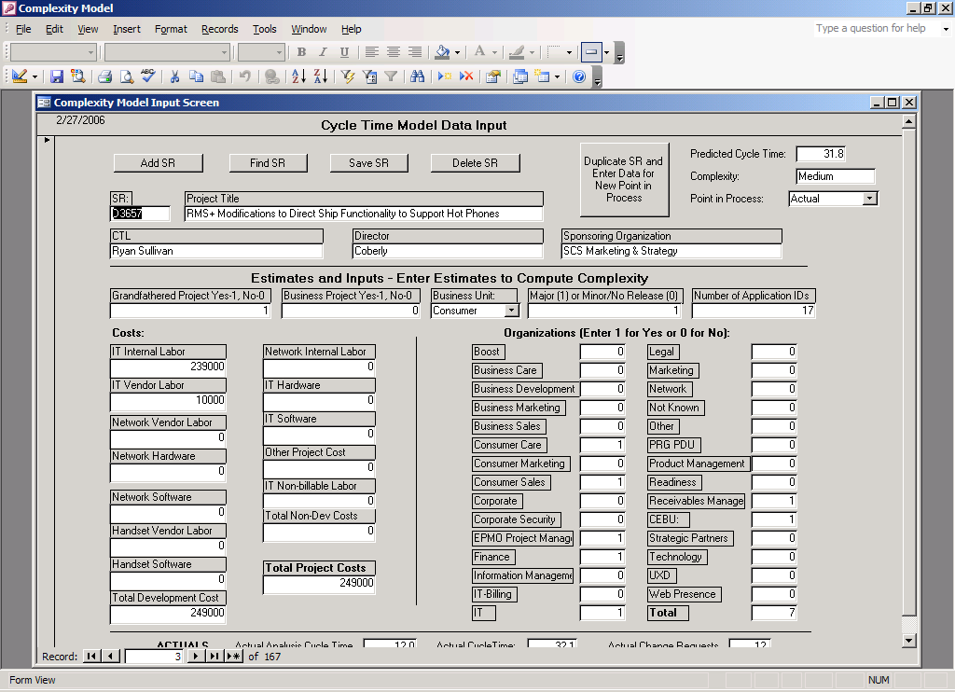
Cycle Time Model - Automated System

Slide 63
Cycle Time Model Enhancements
All Statistics are better when Analysis Cycle Time is included in the models. Testing variables also improve model performance.

Slide 64
Flexible Project Governance System
Less
Governance
Governance
More
Governance
High Level View of model:
Input key project characteristics
Historical Data and Statistical Information
Project Complexity data
Project Governance Index data
Compute Project Complexity Index (PCI)
Compute Project Governance Index (PGI) on an ongoing (monthly) basis
Manage to PGI along with stoplight reporting and required actions

Slide 65
Flexible Project Governance – Operation
Model Operation Procedures
Enter Initial Project Complexity Inputs
Compute Project Complexity Index (PCI)
PCI
Governance Structure
PGI (Monthly)
Recommended Actions
Determine Initial Governance Structure
Enter Project Governance Inputs
Compute Project Governance Index (PGI)
Recommend Governance Actions
Take Actions

Slide 66
Flexible Project Governance – Input
Custom Project Governance Management System Input
SR #
Current Phase
Project Health
Project Earned Value Data:
Budgeted at Completion
% Complete
Planned Value
Actual Cost (Est.)
Phase Data:
Duration in Phase to-date
Cost Expended in Phase to-date
Cycle Time:
Predicted – Project
Current elapsed time – Project
No. of Non-Administrative
Change Requests
Scope Assessment
Team Turnover
Constrained Resources
Sponsor Change
Project complexities
Vendors:
RFP Required:
Alpha/Beta Testing:
Number of Appl IDs:
Network Impacts:
IT Billing Impacts:
CEBU Impacts:
New Technology (new vs existing):
Project Dependencies:
No. Business Areas Impacted:
New Business Process:
Cycle Times Costs
Predicted Actual Forecast Actual Analysis:
Design:
Development:
Test:
Launch:
Total Project:

Slide 67
Project Complexity Index
Compute Project Complexity Index using Multiple Attribute Decision Making
A Project Complexity Index (PCI) is generated to evaluate project complexity factors and assign an overall project complexity level.
TOPSIS is used to generate the index. The traditional TOPSIS methodology generates a relative index. This approach which sets an upper and lower limit to “force” an absolute, not relative index. This is used with the PCI as well as the PGI
Attributes can be weighted with this method.
The PCI is used to determine the initial governance structure for the project.

Slide 68
Project Governance Index
Compute a Project Governance Index – Use project health characteristics to generate an index that represent project health
Use Multiple Attribute Decision Making (TOPSIS or Simple Additive Weights and/or Fuzzy Logic). Using TOPSIS, as with the PCI, the model must be calibrated with an upper and lower limit to generate an absolute index.
PGI mapped to governance actions on a periodic basis (monthly)

Slide 69
Project Governance Actions
Map PGI to governance actions and stoplight reporting
Assess projects on monthly basis, along with the Stoplight reporting and provide PGI along with Stoplight indicator to project managers, managers and directors for overall project review and project intervention requirements
Real Time Project Intervention
PGI Governance Stoplight
0.6+ NA Green
0.5-0.6 Alert Only Yellow
0.4-0.5 Mgr Review Yellow
0.3-0.4 Director Review Yellow
0.2-0.3 VP Review Red
Interim Gate Review
0.0-0.2 Gate Review Red

Slide 70
Planning Team Indicator
Objective
Develop a scientifically based methodology that can be used to determine what projects should be broken down into smaller projects to optimize the work through the pipeline.

Slide 71
Planning Team Indicator
Methodology:
Identify data availability in initial project estimation.
Identify predictive cycle time variables at point in process.
Determine a quantitative or subjective method to represent these variables.
Use the “Absolute Value” TOPSIS methodology to generate absolute index for the Planning Team Indicator.
Calibrate the model to represent the appropriate situations to break down a project into smaller pieces.
Generate Planning Team Indicator and assign planning teams as appropriate.

Slide 72
Planning Team Indicator Methodology
Criteria used to generate the planning team indicator
Resulting Suggestion
Calibrated Indicator
Scaled Values for Criteria

Slide 73
Customer Service Complexity Model
Objective
Refine Customer Service’s Complexity Model to more accurately reflect the complexity involved in supporting new activities in the call centers, and refine the threshold to establish "how much is too much".

Slide 74
Customer Service Complexity Model
Purpose of the Model
To assess the complexity of a particular project to support decision making.
Roll-up the complexity of all projects in the pipeline and determine the impact of a project on overall pipeline complexity.
Preliminary Definition of Complexity
Complexity is defined as the contributing factors that impact a Customer Service Specialist’s ability to deliver high customer satisfaction.

Slide 75
Customer Service Complexity Model
Project Complexity
Pipeline Complexity
Pipeline Complexity
Project complexities
Time to proficiency
Environmental aspects
Compute Pipeline Complexity (Generate Factored Complexity Scores Over Time)
Project Complexity Attributes
Use project complexity attributes to compute complexity
Compute Project Complexity
(Use Project Complexity Attributes to Generate Project Complexity Index)
Pipeline Complexity
Project Complexity Index
Thresholds/Capacities
Factored Complexity Scores
Complexity Thresholds
Delivery method capacities
Learning time capacities
Assess Capacities and Thresholds
Performance Tracking
Weekly Performance Metrics
Overall Sprint Satisfaction
Specialist Handling Satisfaction
First Call Resolution
Other Metrics
Weekly project complexities in aggregate, and by LOB
Number of projects by delivery method
Total required learning times
Assess Weekly Performance Metrics Against Weekly Project Complexities to Assess Relationships
Adjust Thresholds and Capacities

Slide 76
Complexity Attributes and Scoring Model

Slide 77
Pipeline Complexity
Pipeline Complexity: Equals the sum of the individual project complexity
Proficiency Factor: Use the concept of learning curves (Wright’s Learning Curve Model) to represent complexity impact on an ongoing basis

Slide 78
Complexity Threshold
Initial Threshold set at 75% average capacity
Refine Threshold with Relationships between Representative Performance Data
Forward view based on projects already in pipeline
Actuals based on Launch Date

Slide 79
Threshold Analysis
Use pipeline complexity and specialist performance scores to establish thresholds based on minimum acceptable overall specialist satisfaction and/or other performance metrics
Complexity Threshold

Slide 80
Summary
Solution methodology, backed by theory, can be patented to protect new ways of doing business.
When developing new solution approaches, consult with your legal department to determine whether the idea, system or method is patentable.

Slide 81
IMSE 991 Multiple Criteria Decision Making
Lecture 6
TOPSIS and SAW

